Slide 1
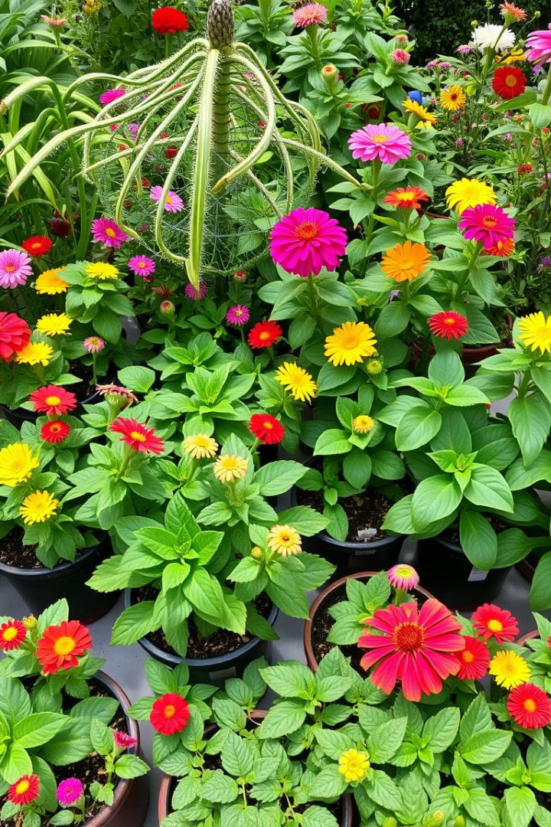
Introduction to Plants
Plants are living things that are essential for life on Earth. They provide us with food, oxygen, and shelter. We can find plants in many places, like our gardens, parks, and forests.
by Amal AlAmri

Slide 2
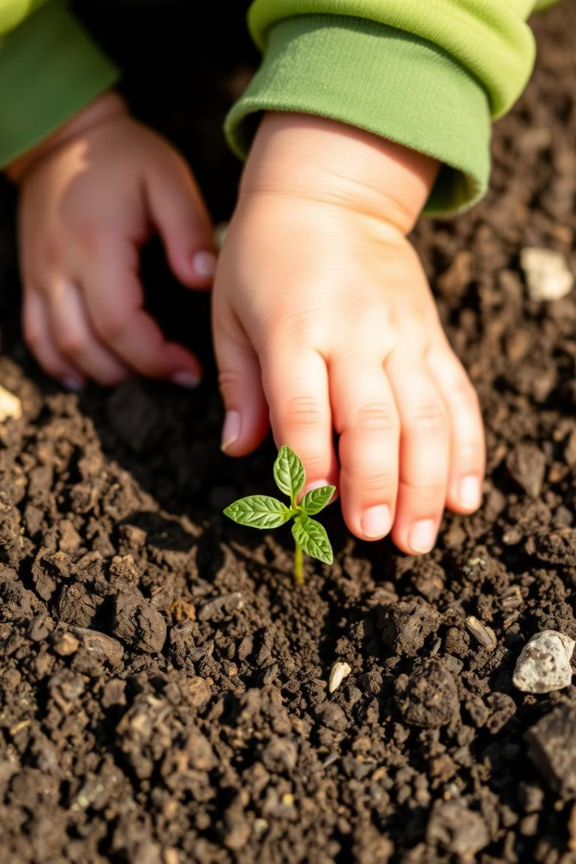
Seed Planting
1
Choosing Seeds
2
Preparing the Soil
Start with seeds that are easy to grow, like sunflowers or beans. Look for seeds that are healthy and not damaged.
Fill a pot with potting soil. Make sure the soil is moist but not too wet. Water it well.
3
Planting the Seeds
4
Watering and Sunlight
Make a small hole in the soil and gently drop the seed in. Cover the seed with a little bit of soil.
Water the seed regularly and place the pot in a sunny spot. The seed needs water and sunlight to germinate.

Slide 3
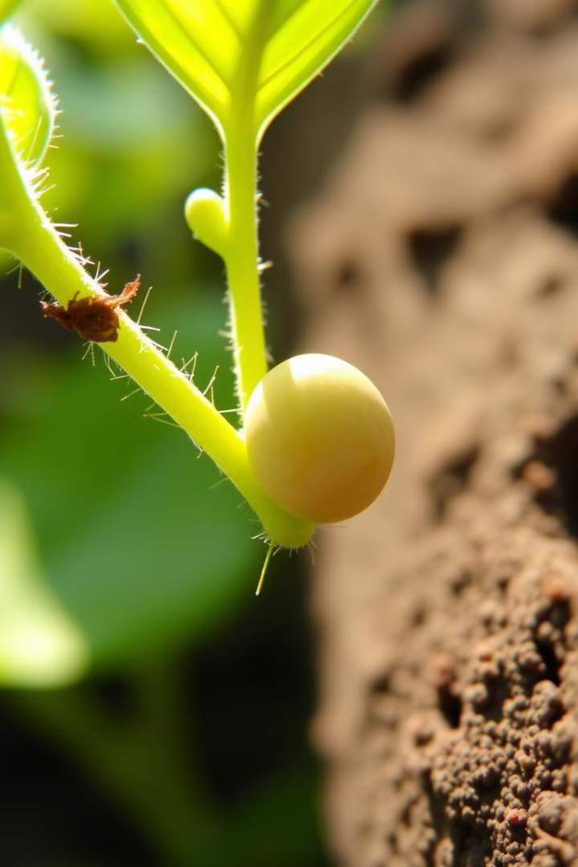
Observing Plant Growth
1
Germination
The seed will start to sprout and a tiny root will emerge first.
2
Stem Growth
The stem will grow upwards and the first leaves will appear.
3
Leaf Development
The plant will grow more leaves and become stronger.
4
Flowering
Some plants will produce flowers, which will eventually turn into fruits or seeds.

Slide 4
Parts of a Plant
Roots
Stem
Leaves
Roots anchor the plant in the soil and absorb water and nutrients.
The stem supports the plant and carries water and nutrients to the leaves.
Leaves are where the plant makes food through photosynthesis.

Slide 5
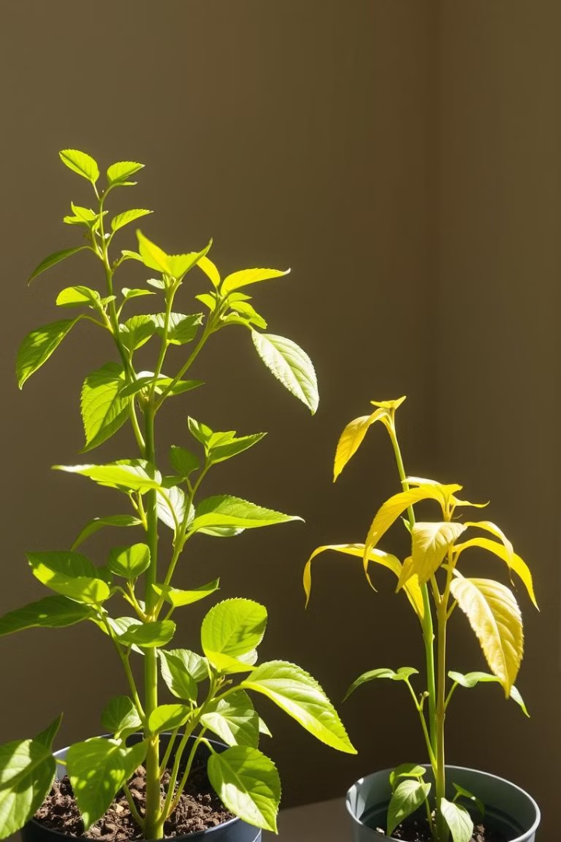
Photosynthesis Experiment
Set Up
Place two identical plants in separate containers, one in a dark room and one in sunlight.
Observation
Observe the plants for a few days. The plant in sunlight should stay healthy, while the one in the dark will wilt.
Conclusion
This shows that sunlight is essential for photosynthesis, the process by which plants make their own food.

Slide 6
Life Cycle of a Plant
Seed
1
The life cycle of a plant begins with a seed.
2
Sprouting
The seed germinates and a small plant emerges.
Growth
3
The plant grows taller and develops leaves.
4
Flowering
The plant produces flowers, which are important for reproduction.
Fruiting
5
The flowers develop into fruits, which contain seeds.
6
Seed Dispersal
The seeds are dispersed, and the cycle starts again.

Slide 7
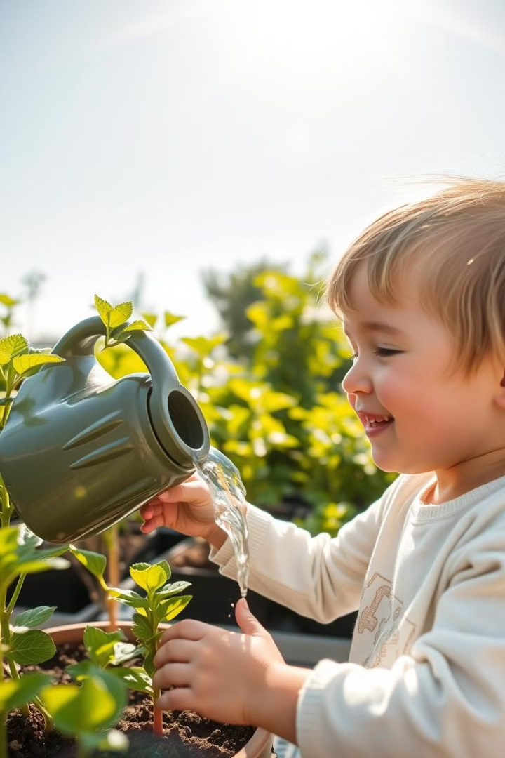
Caring for Plants
Watering
Sunlight
Plants need water to survive. Water them regularly, but avoid overwatering.
Most plants need sunlight to grow. Place them in a sunny spot.
Soil
Fertilizer
Use good quality soil that provides the right nutrients for the plant.
Use a balanced fertilizer to help the plant grow strong and healthy.

Slide 8
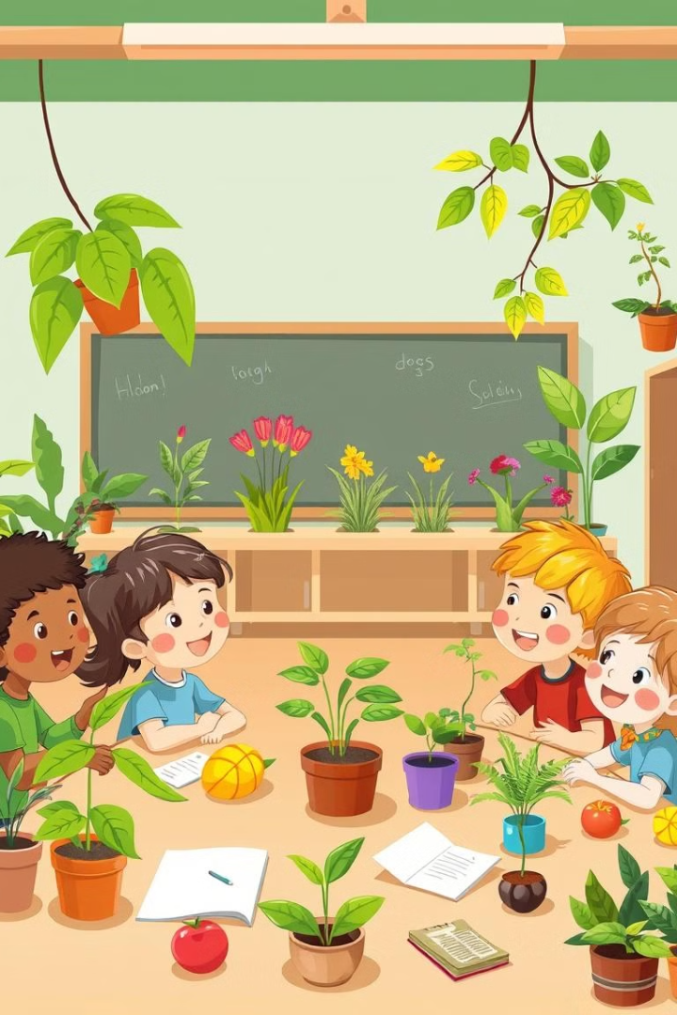
Conclusion and Review
Plant Parts
Photosynthesis
Review the different parts of a plant and their functions.
Discuss how plants use sunlight to make food.
Life Cycle
Importance of Plants
Recap the stages of a plant's life cycle.
Explain why plants are important for our world and for us.

