Slide 1
Doen by : lubna hamed

Slide 2
Differrent types of animals
Insects
Birds
Mammals
Amphibians
Fishes
Reptiles

Slide 3
Objectives
Explain how things that are living that were once alive and that have never lived are different.
Create tables and diagrams to show observations.
Learn to sort and classify things through observation.
Know the common life of plants and animals.
Living things need nutrition.
Living things grow.
Living things move.
Living things reproduce.
Name the features of fish, reptiles , mammels, Birds, Amphebians, and Insects.

Slide 4
Age: 6-7 years
period : 30-40 min
Materials : aanimals – flash cards- pictures of animals – work sheet
Vocabulary: living thing – non living thing – move- nutrition- grow- reprouduce
Birds- mammals- reptails-insects- fishes- amphabian

Slide 5
How things are grouped
The teacher took the students for around to the school garden to observe living things and non living things depending on what they learned last year about living things and non living things.
The students started finding things.
The first student said the grass and the trees are living things.
The second student said the clouds are not alive they can move but they cannot do other things that living things can do.
The third student said the leaves and twigs on ground are things that were once alive they used to be apart of a tree.
The fourth student said sand is a thing that has never lived.

Slide 6
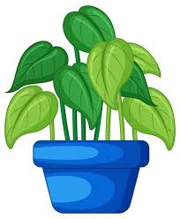
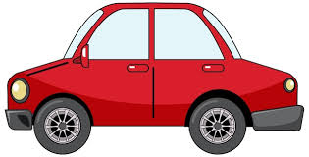
The teacher gave each boy a group of things to ask them to sort into living things and non living things :
Living thing
Living thing
non- Living thing
Living thing
non- Living thing
non- Living thing

Slide 7
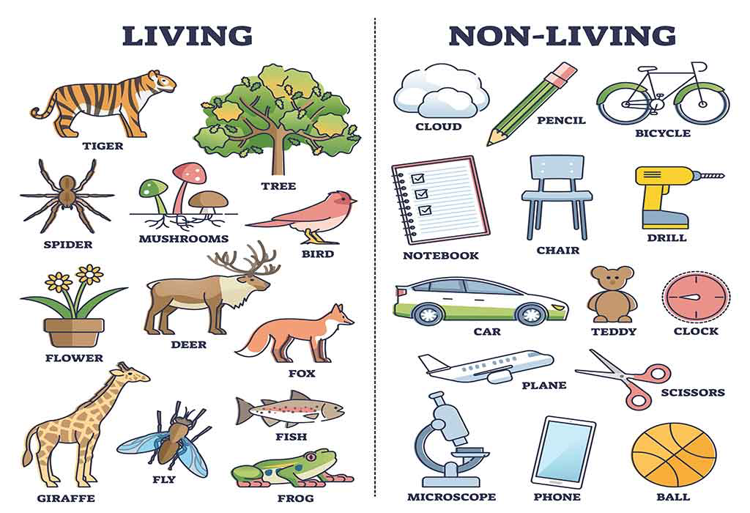
The teacher give each student work sheet to sort the pictures of things to living and non living things :

Slide 8
How things are grouped
The teacher took the students for around to the school garden to observe a plant and a animal to observe what the plant and the animal are doing
The first student said both need food
The second student said both need water
The third student said the animal can have babies
The fourth student said the animal can move but the the plant cant move

Slide 9
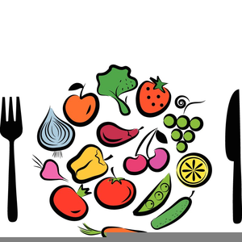
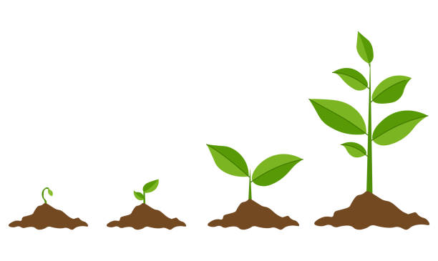
the teacher give each boy group of pictures and ask him to match the wordwith what the picture show
grow
Nutrition

Slide 10
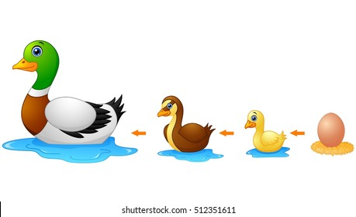
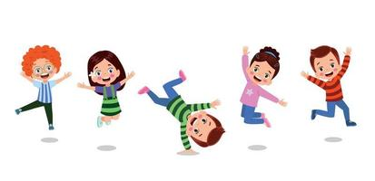
Reproduce
Move

Slide 11
Different groups of animals
The teacher take the student for around to school garden to observe groups of animals :
The first student some animals give birth and some layed eggs
The second student said wings and feathers.
The third student said some have fur.
The fourth student said some have scales too.
The fifth student said some live in the water and some on the ground.

Slide 12
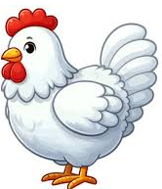
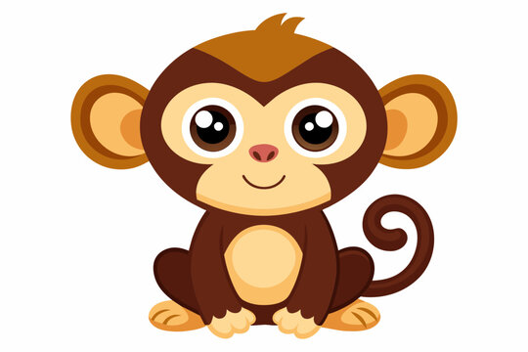
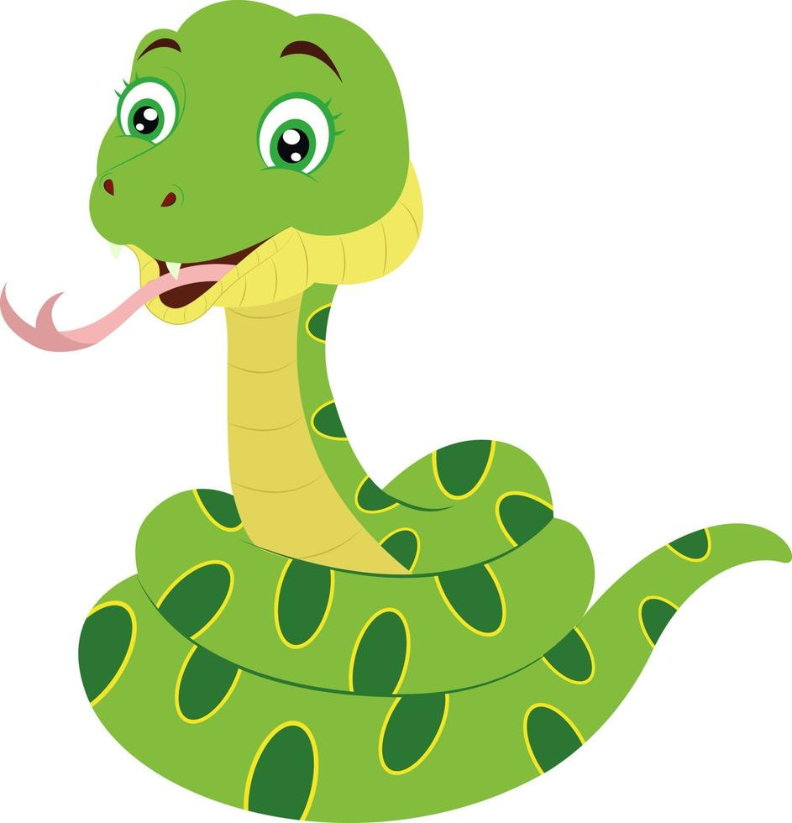
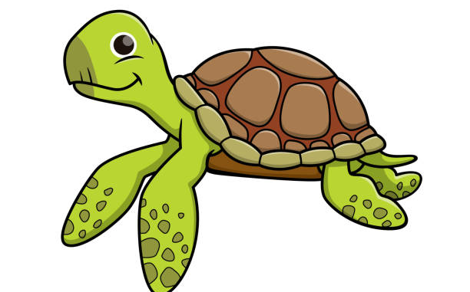
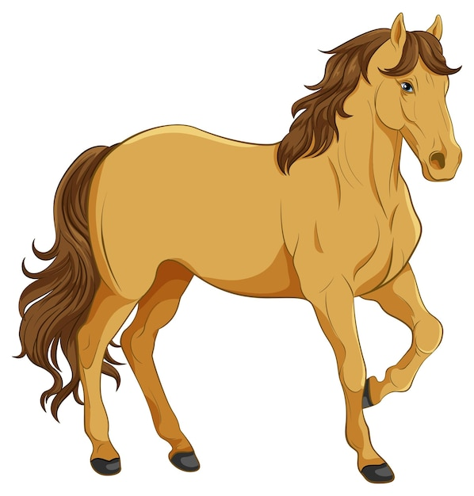
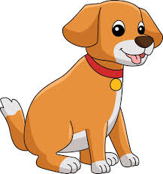
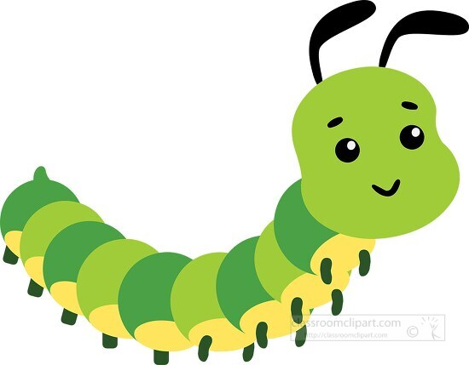
the teacher give each boy group of pictures ask him or her to sort to animals give birth and animals lay eggs
Animals that give birth: | Animals that lay eggs:

Slide 13
The teacher brought a bird to ask the students and What do you guys see ? The students answered “We can see a bird.” What covers it’s body ? The students answered “Feathers!” Can you describe the bird ? “It has beak and wings” the students answered

Slide 14
Bird
feather
Beak
wings

Slide 15
The teacher brought a cat asked the students What did they see ? The students answered we can see acat What covers its body ? The students answered Fur The teacher shows the student different pictures of mammals. The students have to observe that some mammals have fur and others have hair and some live in the water and use their lungs to breathe underwater.

Slide 16
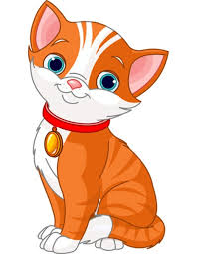
Mammal
fur
legs

Slide 17
The teacher brought a turtle and asked the students What did they see ? The students answered We can see a turtle! What covers its body ? The students answer a shell. The teacher showed the students different pictures of reptiles like snakes The students have to observe that reptiles have scales and lay eggs.

Slide 18
Reptiles
shell

Slide 19
The teacher brought pictuers of insects and asked the students. What did they see ? The students answered We can see a butterfly , bee and a fly. How many parts does their body have? The students answered three parts (head-thorax-and abdomen) What do the insects have on their head? The student will answer antennaes

Slide 20
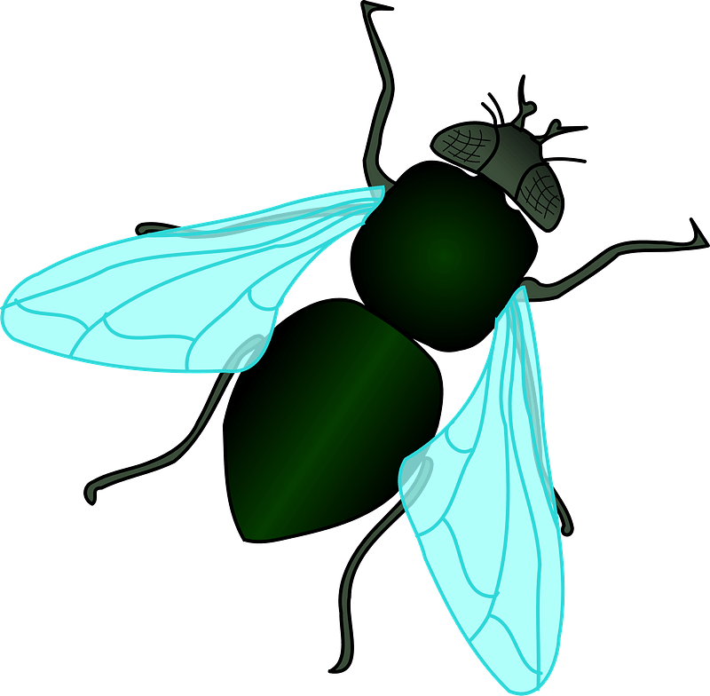
Insectes
Antennaes
Head
Abdomen
thorax
Integration with math: how many body part does it have ?

Slide 21
The teacher brought a fish to ask the students What did they see ? The students answered we can see a fish. What does covers itn’s body ? The students answered Scales. Where do the fishes live? The students answered in the water. What they use to breath? The student answered they use their gills to breathe.

Slide 22
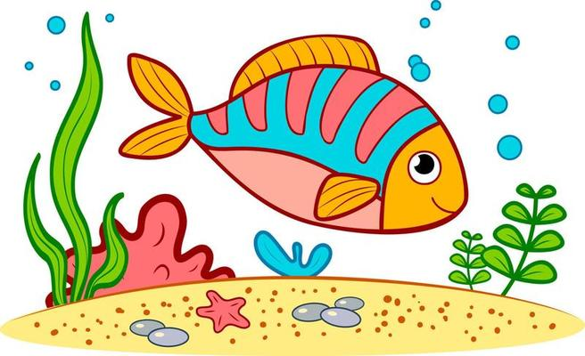
fishes
scales
fins
tail

Slide 23
The teacher brought a frog to ask the students What do they see ? The students will answer We can see a frog. What does cover its body ? The students answered moist skin. Where do they lay eggs? The students will answer in the water What do they use to breathe ? The student will answer they use their gills to breathe in the water When they become adults they develop lungs to breathe

Slide 24
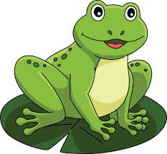
amphabians
Moist skin

Slide 25
Thank you for Reading!

