Slide 1


Sensorial Life Academy
2024-10-3
GRADUATION
PROJECT
KADI ALMUALLIM

Slide 2



INTRODUCTION
Graduation project in Cultural life (science)
The project suitable for preschool

Slide 3



OBJECTIVES
To learn about chemical reactions when ingredients mixed together and their functions

Slide 4

USED ITEMS
BAKING
SODA
VINEGAR
  TRAY
  SPOONE
  EMP TY BOTTLE
  BIG FUNNEL
  SMALL FUNNEL
  BALLOON

Slide 5
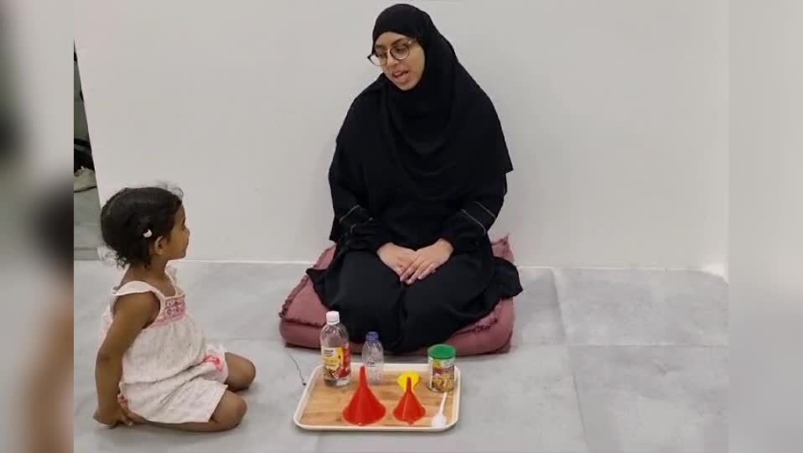

EXPERIMENT VIDEO

Slide 6
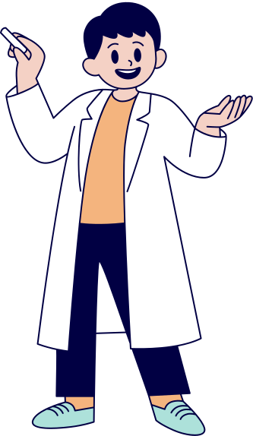
CHEMICAL ANALYSIS
The gas resulted (carbon oxide) from the chemical reaction of the two ingredients (vinegar and baking soda) has the ability to blow out the balloon

Slide 7


Thanks!

